Slide 1
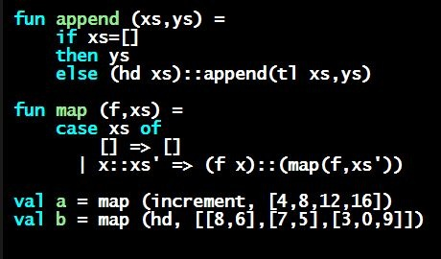
Programming Languages Dan Grossman
Functions (Formally)

Slide 2
Function bindings: 3 questions
Syntax:
(Will generalize in later lecture)
Evaluation: A function is a value! (No evaluation yet)
Adds x0 to environment so later expressions can call it
(Function-call semantics will also allow recursion)
Type-checking:
Adds binding x0 : (t1 * … * tn) -> t if:
Can type-check body e to have type t in the static environment containing:
“Enclosing” static environment (earlier bindings)
x1 : t1, …, xn : tn (arguments with their types)
x0 : (t1 * … * tn) -> t (for recursion)
fun x0 (x1 : t1, … , xn : tn) = e

Slide 3
More on type-checking
fun x0 (x1 : t1, … , xn : tn) = e
New kind of type: (t1 * … * tn) -> t
Result type on right
The overall type-checking result is to give x0 this type in rest of program (unlike Java, not for earlier bindings)
Arguments can be used only in e (unsurprising)
Because evaluation of a call to x0 will return result of evaluating e, the return type of x0 is the type of e
The type-checker “magically” figures out t if such a t exists
Later lecture: Requires some cleverness due to recursion
More magic after hw1: Later can omit argument types too

Slide 4
Function Calls
A new kind of expression: 3 questions
Syntax:
(Will generalize later)
Parentheses optional if there is exactly one argument
Type-checking:
If:
e0 has some type (t1 * … * tn) -> t
e1 has type t1, …, en has type tn
Then:
e0(e1,…,en) has type t
Example: pow(x,y-1) in previous example has type int
e0 (e1,…,en)

Slide 5
Function-calls continued
e0(e1,…,en)
Evaluation:
(Under current dynamic environment,) evaluate e0 to a function fun x0 (x1 : t1, … , xn : tn) = e
Since call type-checked, result will be a function
(Under current dynamic environment,) evaluate arguments to values v1, …, vn
Result is evaluation of e in an environment extended to map x1 to v1, …, xn to vn
(“An environment” is actually the environment where the function was defined, and includes x0 for recursion)

